Slide 1


The Health of a Leader

Slide 2
The Health of a Leader
Three common myths about your health as a leader:

Slide 3
The Health of a Leader
Three common myths about your health as a leader:
It is spiritual to be unhealthy

Slide 4
The Health of a Leader
Three common myths about your health as a leader:
It is spiritual to be unhealthy
  “To care for myself is selfish”

Slide 5
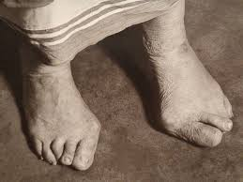
The Health of a Leader
Three common myths about your health as a leader:
It is spiritual to be unhealthy

Slide 6
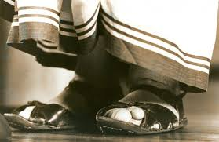
The Health of a Leader
Three common myths about your health as a leader:
It is spiritual to be unhealthy

Slide 7
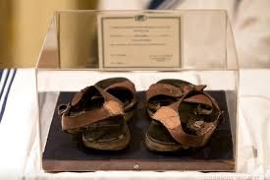
The Health of a Leader
Three common myths about your health as a leader:
It is spiritual to be unhealthy

Slide 8
The Health of a Leader
Three common myths about your health as a leader:
2. It is easy to stay healthy

Slide 9
The Health of a Leader
Three common myths about your health as a leader:
2. It is easy to stay healthy
The Barna group reported in 2022 that 42% of evangelical pastors were seriously considering stepping away from full-time ministry.

Slide 10
The Health of a Leader
Three common myths about your health as a leader:
2. It is easy to stay healthy
According to the same study, 40% now show a high risk of burnout. That’s a 400% increase since 2015 .

Slide 11
The Health of a Leader
Three common myths about your health as a leader:
2. It is easy to stay healthy
According to another study 90% of pastors work long hours, and 91% report experiencing some form of burnout, with 18% feeling completely exhausted.

Slide 12
The Health of a Leader
Three common myths about your health as a leader:
2. It is easy to stay healthy
  You need to fight for your health. It is not easy.

Slide 13
The Health of a Leader
Three common myths about your health as a leader:
3. Once you gain health, you will automatically retain it

Slide 14
The Health of a Leader
Three common myths about your health as a leader:
3. Once you gain health, you will automatically retain it
  How many great leaders do you know who have fallen?

Slide 15
The Health of a Leader
Three common myths about your health as a leader:
3. Once you gain health, you will automatically retain it
  Your health is under attack

Slide 16
The Health of a Leader
Three common myths about your health as a leader:
3. Once you gain health, you will automatically retain it
  Your health is under attack
  I Cor 10:12 – “Therefore let anyone who thinks that he stands take heed lest he fall.”

Slide 17
The Health of a Leader
What is God’s desire for you as a leader?

Slide 18
The Health of a Leader
What is God’s desire for you as a leader?
He gives strength to the weary
and increases the power of the weak.
Even youths grow tired and weary,
and young men stumble and fall;
but those who hope in the LORD
will renew their strength.
They will soar on wings like eagles;
they will run and not grow weary,
they will walk and not be faint.
Isaiah 40:29-31

Slide 19
The Health of a Leader
Instructions from your health coach

Slide 20
The Health of a Leader
Instructions from your health coach
He gives strength to the weary
and increases the power of the weak

Slide 21
The Health of a Leader
Instructions from your health coach
He gives strength to the weary
and increases the power of the weak
those who hope in the LORD
will renew their strength.

Slide 22
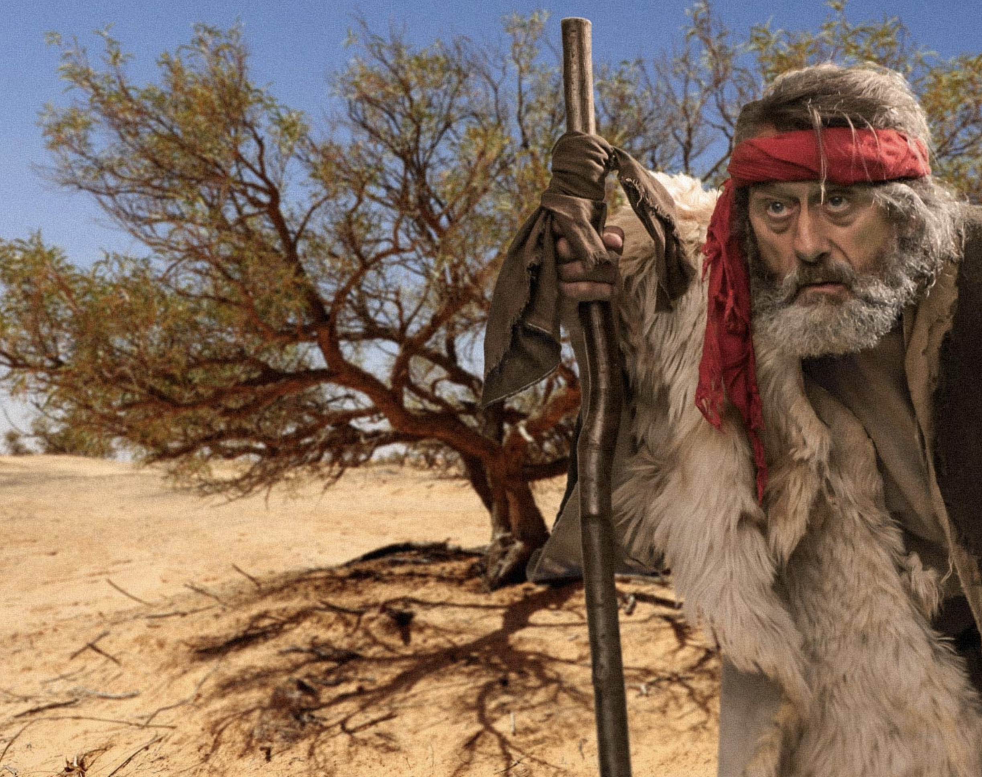
The Health of a Leader
Instructions from your health coach:
I Kings 19

Slide 23
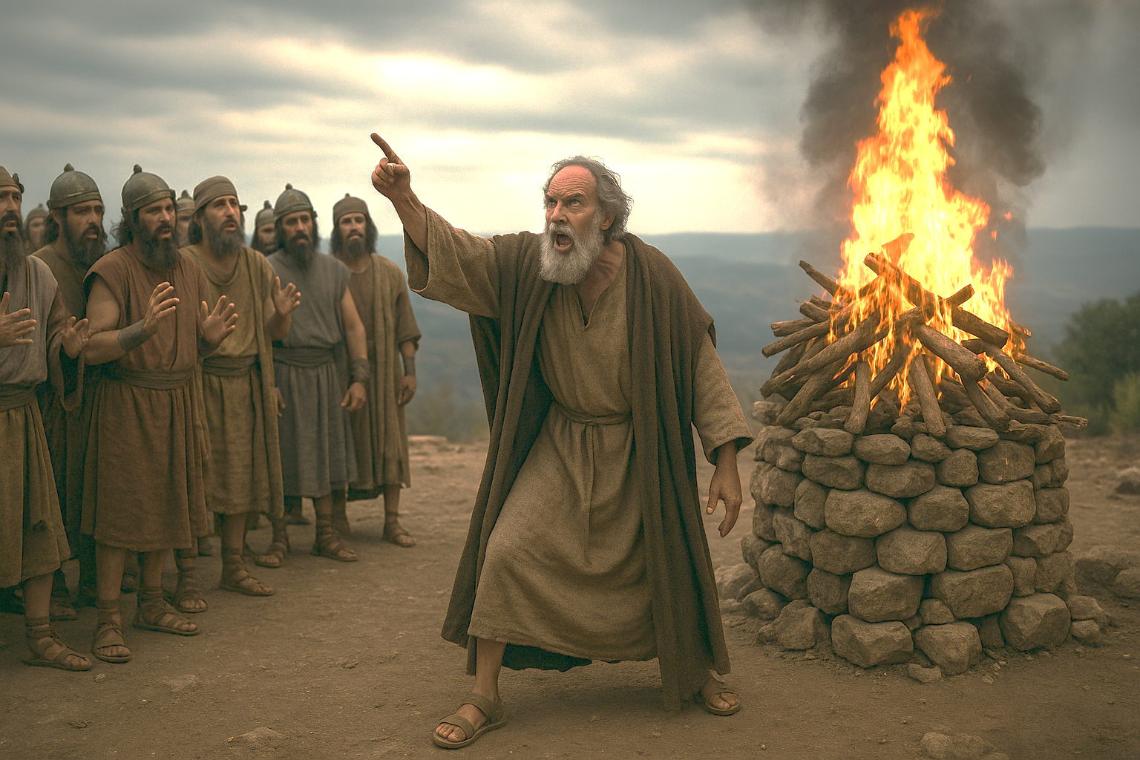
The Health of a Leader
Instructions from your health coach:
I Kings 19

Slide 24
The Health of a Leader
Instructions from your health coach:
I Kings 19

Slide 25
The Health of a Leader
Instructions from your health coach:
Stop – and be honest – I Kings 19:1-4

Slide 26
The Health of a Leader
Instructions from your health coach:
Stop – and be honest – I Kings 19:1-4
  about your relational pain

Slide 27
The Health of a Leader
Instructions from your health coach:
Stop – and be honest – I Kings 19:1-4
  about your relational pain
  about your negative emotions

Slide 28
The Health of a Leader
Instructions from your health coach:
Stop – and be honest – I Kings 19:1-4
  about your relational pain
  about your negative emotions
  about your discouragement

Slide 29
The Health of a Leader
Instructions from your health coach:
Stop – and be honest – I Kings 19:1-4
  about your relational pain
  about your negative emotions
  about your discouragement
  about your view of yourself

Slide 30
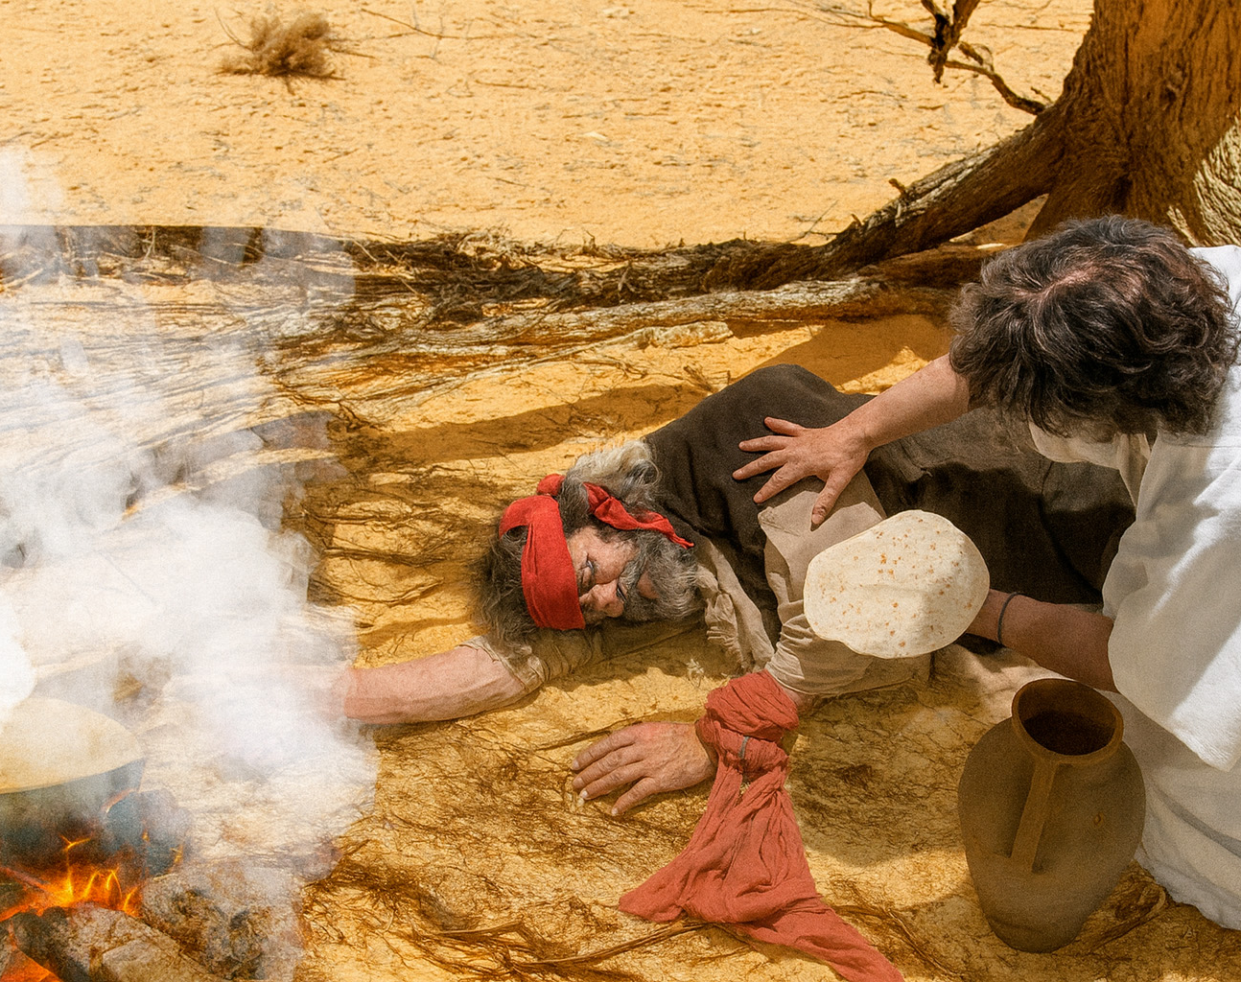
Instructions from your health coach:
2. Care for your physical health– I Kings 19:1-4

Slide 31
Instructions from your health coach:
2. Care for your physical health– I Kings 19:1-4
    Sleep

Slide 32
Instructions from your health coach:
2. Care for your physical health– I Kings 19:1-4
    Sleep
    "Fatigue makes cowards of us all”
    General George Patton

Slide 33
Instructions from your health coach:
2. Care for your physical health– I Kings 19:1-4
    Sleep
    Eat

Slide 34
Instructions from your health coach:
2. Care for your physical health– I Kings 19:1-4
    Sleep
    Eat

Slide 35
Instructions from your health coach:
2. Care for your physical health– I Kings 19:1-4
    Sleep
    Eat
    Drink

Slide 36
Instructions from your health coach:
2. Care for your physical health– I Kings 19:1-4
    Sleep
    Eat
    Drink
    "Water is the most neglected nutrient in your diet, but one of the most vital."

Slide 37
Instructions from your health coach:
2. Care for your physical health– I Kings 19:1-4
    Sleep
    Eat
    Drink
    "Pure water is the world's first and foremost medicine.”

Slide 38
Instructions from your health coach:
2. Care for your physical health– I Kings 19:1-4
    Sleep
    Eat
    Drink
    "Thousands have lived without love, not one without water"

Slide 39
Instructions from your health coach:
2. Care for your physical health– I Kings 19:1-4
    Sleep
    Eat
    Drink
    Exercise

Slide 40
Instructions from your health coach:
2. Care for your physical health– I Kings 19:1-4
    Sleep
    Eat
    Drink
    Exercise
    "We do not stop exercising because we grow old – we grow old because we stop exercising."

Slide 41
Instructions from your health coach:
2. Care for your physical health– I Kings 19:1-4
    Sleep
    Eat
    Drink
    Exercise
    "If you don't make time for exercise, you will probably have to make time for illness.”

Slide 42
Instructions from your health coach:
2. Care for your physical health– I Kings 19:1-4
    Sleep
    Eat
    Drink
    Exercise
    "Exercise is the most potent and underrated antidepressant." - Bill Phillips

Slide 43
Instructions from your health coach:
2. Care for your physical health– I Kings 19:1-4
    Sleep
    Eat
    Drink
    Exercise
    "Physical activity is 1.5 times more effective at reducing mild-to-moderate symptoms of depression, psychological stress and anxiety than medication or cognitive behavior therapy.”

Slide 44
Instructions from your health coach:
2. Care for your physical health– I Kings 19:1-4
    Sleep
    Eat
    Drink
    Exercise

Slide 45

Instructions from your health coach:
3. Care for your spiritual health– I Kings 19:10-14

Slide 46

Instructions from your health coach:
3. Care for your spiritual health– I Kings 19:10-14
Mount Horeb

Slide 47
Instructions from your health coach:
3. Care for your spiritual health– I Kings 19:10-14
Mount Horeb
Where do you go to have longer conversations with God?

Slide 48
Instructions from your health coach:
3. Care for your spiritual health– I Kings 19:10-14
Elijah’s complaint – vs 10

Slide 49
Instructions from your health coach:
3. Care for your spiritual health– I Kings 19:10-14
Elijah’s complaint – vs 10
Time, rest, change of location, distance from difficult people, and the removal of stress has not changed him.

Slide 50
Instructions from your health coach:
3. Care for your spiritual health– I Kings 19:10-14
Elijah’s complaint – vs 10
Time, rest, change of location, distance from difficult people, and the removal of stress has not changed him.
“Wherever you go, there you are”

Slide 51
Instructions from your health coach:
3. Care for your spiritual health– I Kings 19:10-14
How does God realign my soul and spirit?

Slide 52
Instructions from your health coach:
3. Care for your spiritual health– I Kings 19:10-14
How does God realign my soul and spirit?
  Remind - vs11-13

Slide 53
Instructions from your health coach:
3. Care for your spiritual health– I Kings 19:10-14
How does God realign my soul and spirit?
  Remind - vs11-13
  Reframe – vs 18

Slide 54
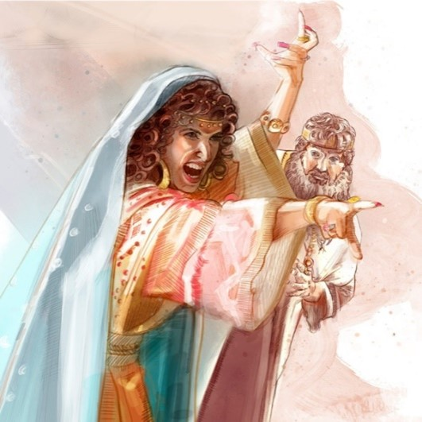

Slide 55
What is happening

Slide 56

What is happening
My frame for interpreting what is happening

Slide 57
“I am the only one left, and now they are trying to kill me too.”
What is happening
My frame for interpreting what is happening

Slide 58

Reframe
What is happening
My frame for interpreting what is happening

Slide 59
Reframe
God is…
Active
Powerful
In control
Gentle
Personal
He has a plan
What is happening
My frame for interpreting what is happening

Slide 60

What is happening to you
Your frame for interpreting what is happening

Slide 61
Reframe
Romans 8:28-32
That
What is happening to you
Your frame for interpreting what is happening

Slide 62
Instructions from your health coach:
3. Care for your spiritual health– I Kings 19:10-14
How does God realign my soul and spirit?
  Remind - vs11-13
  Reframe – vs 18
  Rebuke – Jer 17:1-15

Slide 63
Instructions from your health coach:
3. Care for your spiritual health– I Kings 19:10-14
How does God realign my soul and spirit?
  Remind - vs11-13
  Reframe – vs 18
  Rebuke – Jer 17:1-15
  Renew – Isa 40:31

Slide 64
Instructions from your health coach:
3. Care for your spiritual health– I Kings 19:10-14
How does God realign my soul and spirit?
  Remind - vs11-13
  Reframe – vs 18
  Rebuke – Jer 17:1-15
  Renew – Isa 40:31
    Vertical alignment

Slide 65
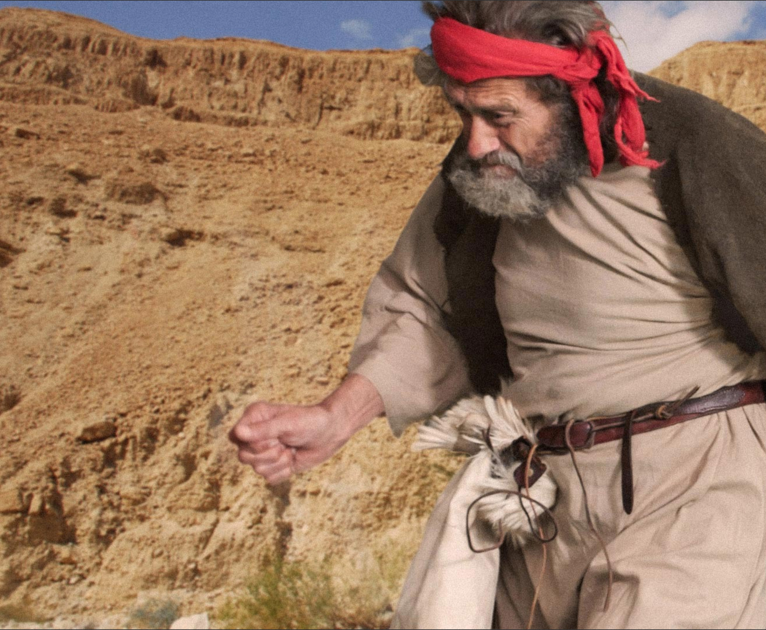
Instructions from your health coach:
4. Work in a healthy way– I Kings 19:15-18

Slide 66
Instructions from your health coach:
4. Work in a healthy way– I Kings 19:15-18
  Focus on your unique instructions

Slide 67
Instructions from your health coach:
4. Work in a healthy way– I Kings 19:15-18
  Focus on your unique instructions
  Empower others

Slide 68
Instructions from your health coach:
4. Work in a healthy way– I Kings 19:15-18
  Focus on your unique instructions
  Empower others
  Work as a team

Slide 69
Instructions from your health coach:
4. Work in a healthy way– I Kings 19:15-18
Follow the rhythms of your Father – John 5:17

Slide 70
Instructions from your health coach:
4. Work in a healthy way– I Kings 19:15-18
Follow the rhythms of your Father – John 5:17
  Daily rhythm – evening and morning - Gen 1:5

Slide 71
Instructions from your health coach:
4. Work in a healthy way– I Kings 19:15-18
Follow the rhythms of your Father – John 5:17
  Daily rhythm – evening and morning - Gen 1:5
  Weekly rhythm – remember the Sabbath – Gen 2:2-3

Slide 72
Instructions from your health coach:
4. Work in a healthy way– I Kings 19:15-18
Follow the rhythms of your Father – John 5:17
  Daily rhythm – evening and morning - Gen 1:5
  Weekly rhythm – remember the Sabbath – Gen 2:2-3
  Yearly rhythm – 7 feasts, Lev 23

Slide 73
Instructions from your health coach:
4. Work in a healthy way– I Kings 19:15-18
Follow the rhythms of your Father – John 5:17
  Daily rhythm – evening and morning - Gen 1:5
  Weekly rhythm – remember the Sabbath – Gen 2:2-3
  Yearly rhythm – 7 feasts, Lev 23
  Multi- year rhythm – a Sabbath for the land (Lev 25, Deut 15)

Slide 74
Instructions from your health coach:
4. Work in a healthy way– I Kings 19:15-18
  Focus on your unique instructions
  Empower others
  Work as a team
  Follow the rhythms of your Father

Slide 75
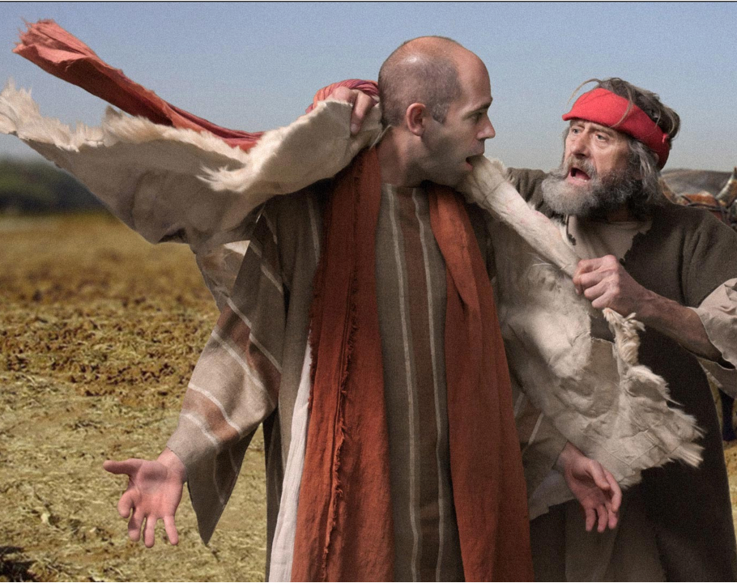
Instructions from your health coach:
5. Invest in your core relationships– I Kings 19:10-14

Slide 76
Instructions from your health coach:
5. Invest in your core relationships– I Kings 19:10-14
  Friends

Slide 77
Instructions from your health coach:
5. Invest in your core relationships– I Kings 19:10-14
  Friends
  Carry your burdens together – vs 19, 21

Slide 78
Instructions from your health coach:
5. Invest in your core relationships– I Kings 19:10-14
  Friends
  Carry your burdens together – vs 19, 21
  Family

Slide 79
Instructions from your health coach:
5. Invest in your core relationships– I Kings 19:10-14
  Friends
  Carry your burdens together – vs 19, 21
  Family
Honor, respect, and care for them vs 20-21

Slide 80

Instructions from your health coach:
Stop, and be honest
Care for your physical health
Care for your spiritual health
Work in healthy ways
Invest in your core relationships

Slide 81

The Elijah Buckets

Slide 82
The Elijah Buckets

Slide 83
The Elijah Buckets

Slide 84

The Elijah Buckets

Slide 85
The Elijah Buckets

Slide 86
The Elijah Buckets
Pain
Emotions
Discourage-ment
View of self
Eat
Sleep
Drink
Exercise
Vertical alignment
Remind
Reframe
Rebuke
Renew
Focus
Empower
Team
Rhythms
Friends
Family

Slide 87
Even youths grow tired and weary,
and young men stumble and fall;
but those who hope in the LORD
will renew their strength.
They will soar on wings like eagles;
they will run and not grow weary,
they will walk and not be faint.
Isaiah 40:29-31

