Slide 1
Multiplying leaders

Slide 2
Multiplying leaders
The Leadership Multiplication Path

Slide 3
Multiplying leaders
The Leadership Multiplication Path
Engines of Leadership Multiplication

Slide 4
Multiplying Leaders

Slide 5
Engines of Leadership Multiplication
Eight “engines”

Slide 6
Engines of Leadership Multiplication
Eight “engines”
  Challenge – John 1:43, Mark 1:17

Slide 7


Engines of Leadership Multiplication
Eight “engines”
  Challenge – John 1:43, Mark 1:17

Slide 8
Engines of Leadership Multiplication
Eight “engines”
  Challenge – John 1:43, Mark 1:17
  Weight – Mark 6:37-44

Slide 9
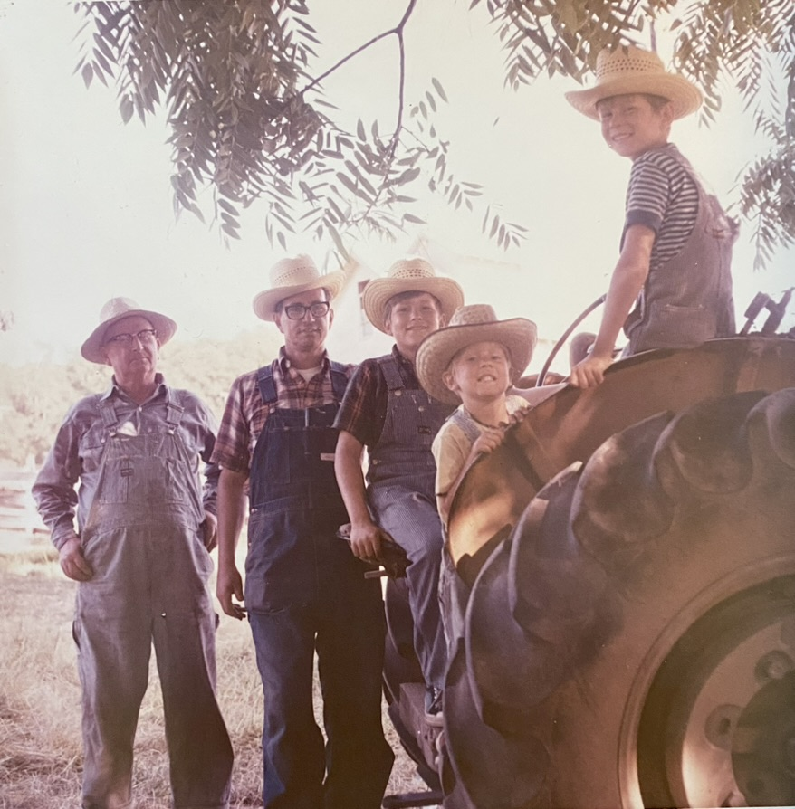

Slide 10
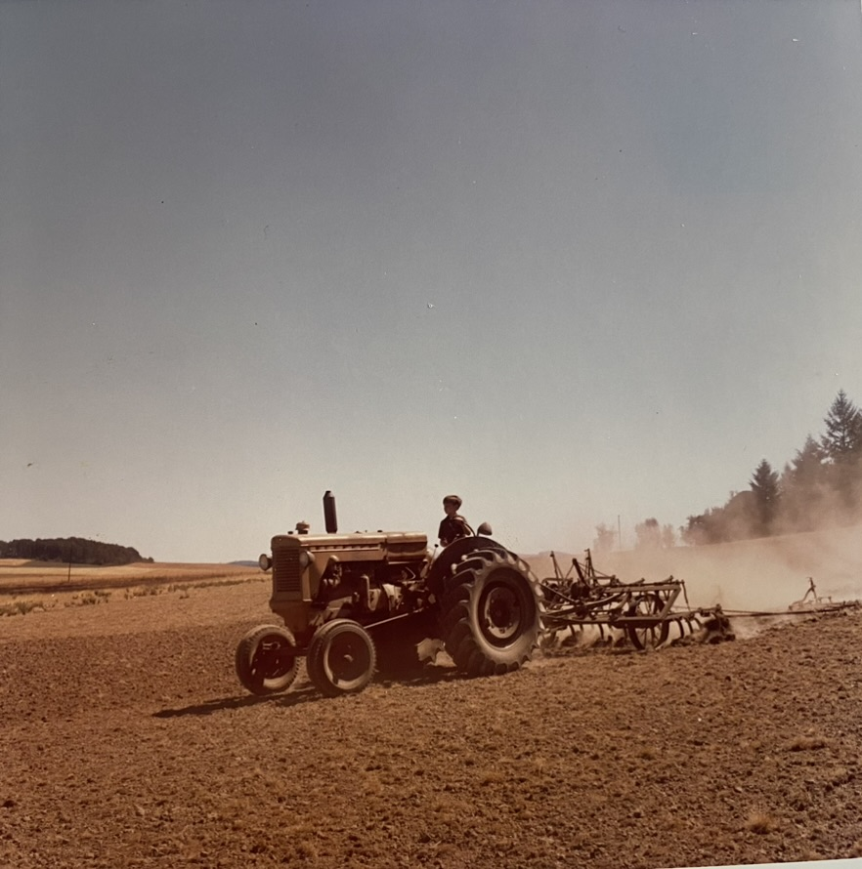

Slide 11
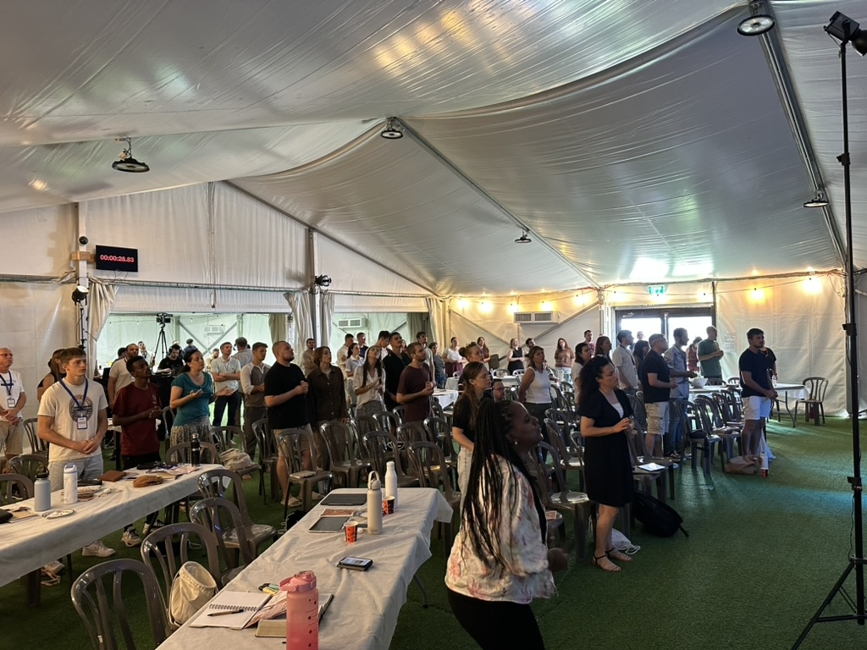

Slide 12
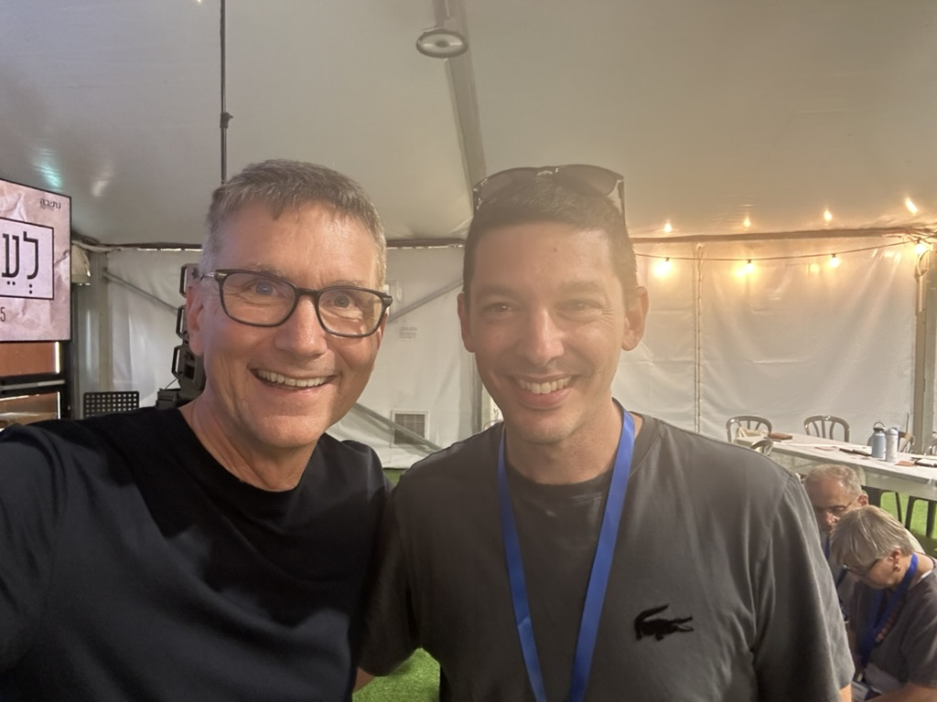

Slide 13
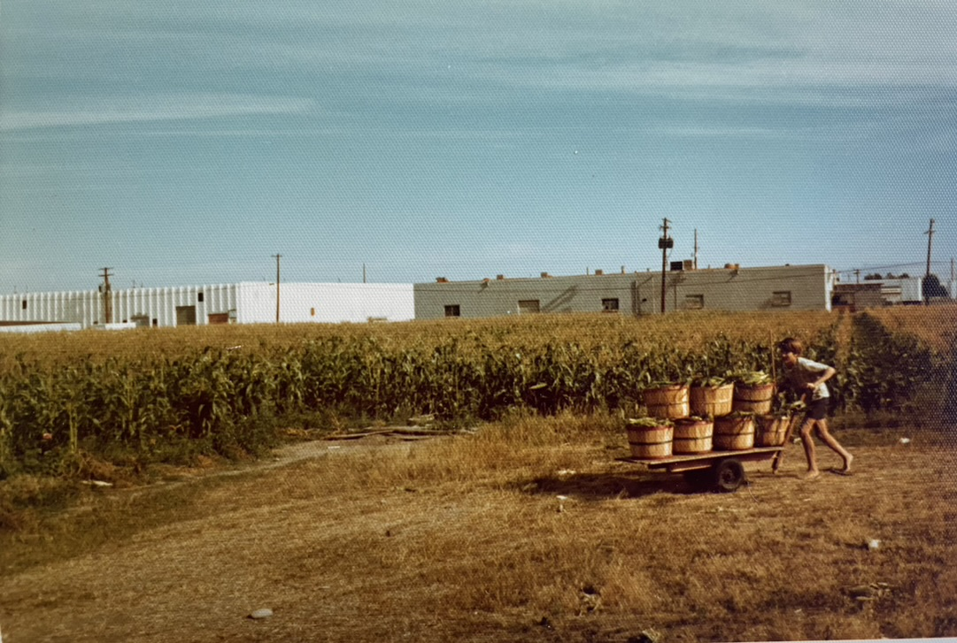

Slide 14
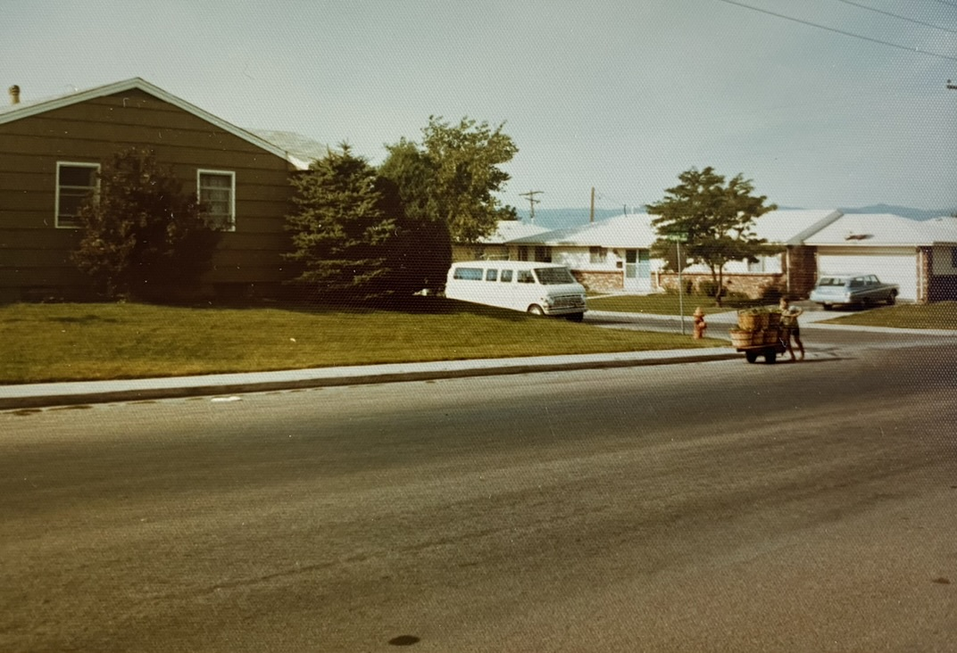

Slide 15
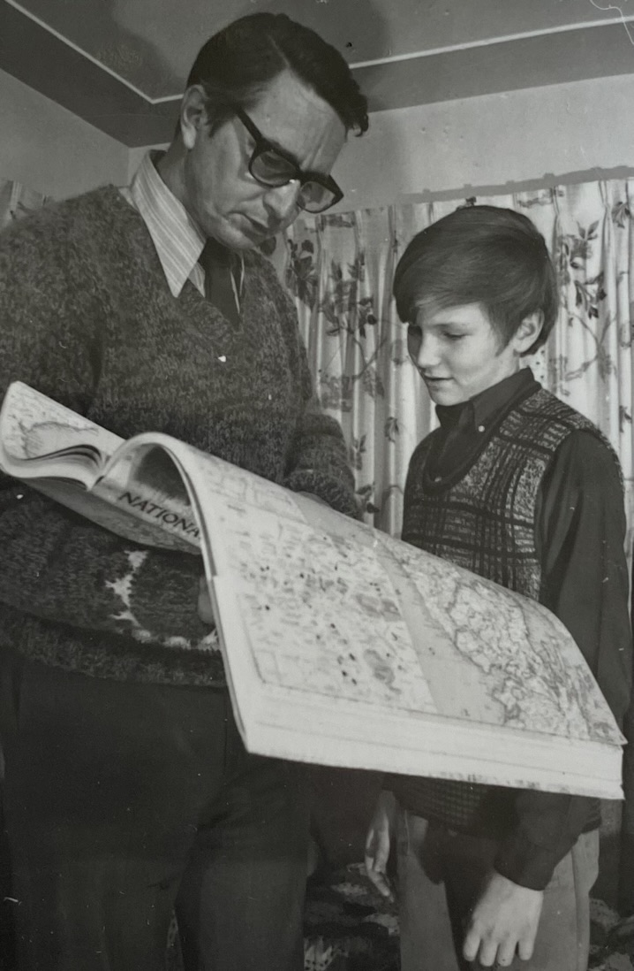

Slide 16


Slide 17
Engines of Leadership Multiplication
Eight “engines”
  Challenge – John 1:43, Mark 1:17
  Weight – Mark 6:37-44
  TAR (teach, act, reflect) – Luke 10:1-20

Slide 18

Engines of Leadership Multiplication
Eight “engines”
  Challenge – John 1:43, Mark 1:17
  Weight – Mark 6:37-44
  TAR (teach, act, reflect) – Luke 10:1-20

Slide 19
Engines of Leadership Multiplication
Eight “engines”
  Challenge – John 1:43, Mark 1:17
  Weight – Mark 6:37-44
  TAR (teach, act, reflect) – Luke 10:1-20
  JIT Resourcing – John 16:12

Slide 20
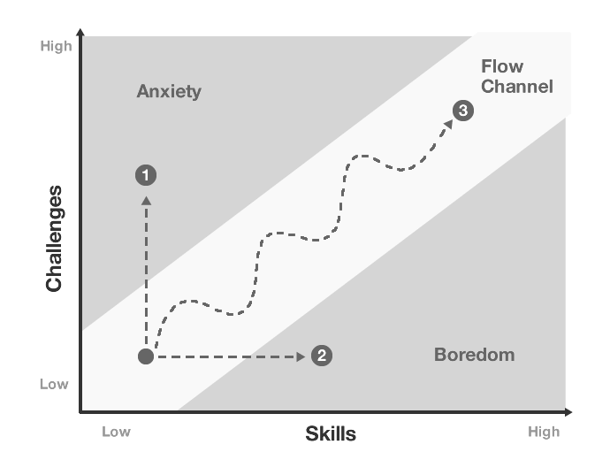

Slide 21
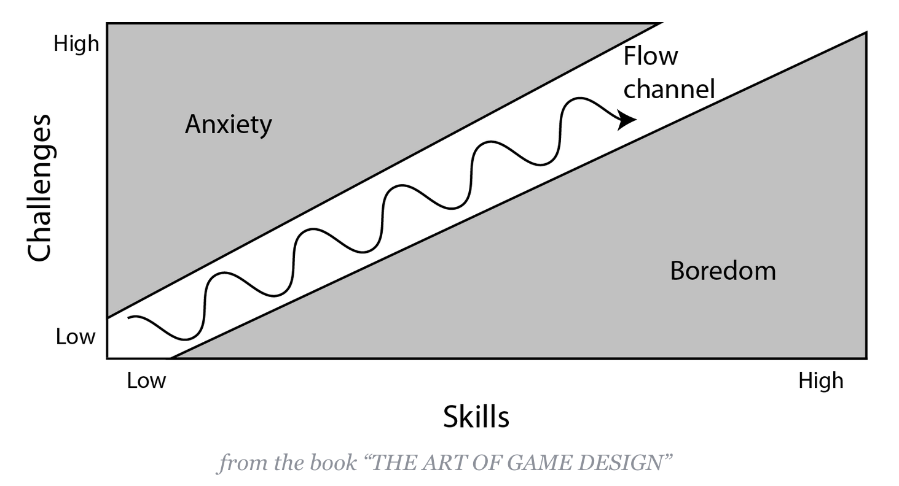

Slide 22
Engines of Leadership Multiplication
Eight “engines”
  Challenge – John 1:43, Mark 1:17
  Weight – Mark 6:37-44
  TAR (teach, act, reflect) – Luke 10:1-20
  JIT Resourcing – John 16:12
  Problems – Matt 17:14-20

Slide 23
Engines of Leadership Multiplication
Eight “engines”
  Challenge – John 1:43, Mark 1:17
  Weight – Mark 6:37-44
  TAR (teach, act, reflect) – Luke 10:1-20
  JIT Resourcing – John 16:12
  Problems – Matt 17:14-20
  Speed modeling – Luke 11:1-11

Slide 24
Engines of Leadership Multiplication
Eight “engines”
  Challenge – John 1:43, Mark 1:17
  Weight – Mark 6:37-44
  TAR (teach, act, reflect) – Luke 10:1-20
  JIT Resourcing – John 16:12
  Problems – Matt 17:14-20
  Speed modeling – Luke 11:1-11
  Leadership “pipelines” – Mark 4:34

Slide 25


Slide 26
Engines of Leadership Multiplication
Eight “engines”
  Challenge – John 1:43, Mark 1:17
  Weight – Mark 6:37-44
  TAR (teach, act, reflect) – Luke 10:1-20
  JIT Resourcing – John 16:12
  Problems – Matt 17:14-20
  Speed modeling – Luke 11:1-11
  Leadership “pipelines” – Mark 4:34
  The Father’s Heart – John 17

Slide 27


Slide 28
Engines of Leadership Multiplication
Eight “engines”
  Challenge – John 1:43, Mark 1:17
  Weight – Mark 6:37-44
  TAR (teach, act, reflect) – Luke 10:1-20
  JIT Resourcing – John 16:12
  Problems – Matt 17:14-20
  Speed modeling – Luke 11:1-11
  Leadership “pipelines” – Mark 4:34
  The Father’s Heart – John 17

Slide 29
Engines of Leadership Multiplication
Discussion Question:
How could you use the eight leadership engines to accelerate leadership multiplication in your family, your local church, in new church plants through M4 and in your team?

